Slide 1
Decision Tree Induction Classifier

Slide 2
Contents
Decision Tree Induction
Classification by Decision Tree Induction with a Training Dataset
Algorithm For Decision Tree Induction
Attribute Selection Measures
Extracting Classification Rules from Trees
Over Fitting in Classification

Slide 3
Why Decision Tree Are So Popular
The construction of decision tree classifiers does not require any domain knowledge
Appropriate for exploratory knowledge discovery.
They can handle multidimensional data
Representation of acquired knowledge in tree form is intuitive
Learning & Classification steps of decision tree are simple & fast.
Good Accuracy Model
Applications are Medicine, Manufacturing & Production , Financial analysis & Molecular Biology.

Slide 4
Classification by Decision Tree Induction
A flow-chart-like tree structure
Internal node denotes a test on an attribute
Branch represents an outcome of the test
Leaf nodes represent class labels or class distribution
Decision tree generation consists of two phases
Tree construction
At start, all the training examples are at the root
Partition examples recursively based on selected attributes
Tree pruning
Identify and remove branches that reflect noise or outliers
Use of decision tree: Classifying an unknown sample
Test the attribute values of the sample against the decision tree

Slide 5
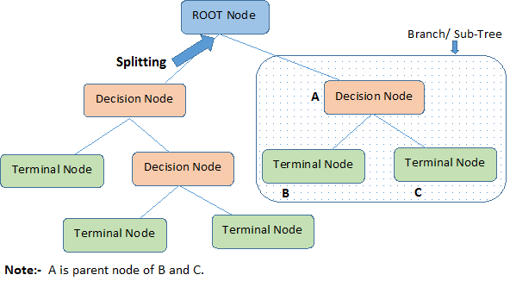

Slide 6
Training Dataset

Slide 7
Output: A Decision Tree for “buys_computer”
age?
<=30
overcast
>40
30..40
student?
yes
credit rating?
no
yes
excellent
fair
no
yes
no
yes

Slide 8
Decision Tree Classification Task
Decision Tree

Slide 9
Example of a Decision Tree
categorical
categorical
continuous
class
Splitting Attributes
Home Owner
Yes
No
NO
MarSt
Married
Single, Divorced
Income
NO
< 80K
> 80K
NO
YES
Model: Decision Tree
Training Data

Slide 10
Another Example of Decision Tree
categorical
categorical
continuous
MarSt
Single, Divorced
class
Married
NO
Home Owner
Yes
No
NO
Income
< 80K
> 80K
NO
YES
There could be more than one tree that fits the same data!

Slide 11
Apply Model to Test Data
Start from the root of tree.
Test Data
Home Owner
Yes
No
NO
MarSt
Single, Divorced
Married
Income
NO
< 80K
> 80K
NO
YES

Slide 12
Apply Model to Test Data
Test Data
Home Owner
Yes
No
NO
MarSt
Single, Divorced
Married
Income
NO
< 80K
> 80K
NO
YES

Slide 13
Apply Model to Test Data
Test Data
Home Owner
Yes
No
NO
MarSt
Single, Divorced
Married
Income
NO
< 80K
> 80K
NO
YES

Slide 14
Apply Model to Test Data
Test Data
Home Owner
Yes
No
NO
MarSt
Single, Divorced
Married
Income
NO
< 80K
> 80K
NO
YES

Slide 15
Apply Model to Test Data
Test Data
Home Owner
Yes
No
NO
MarSt
Single, Divorced
Married
Income
NO
< 80K
> 80K
NO
YES

Slide 16
Apply Model to Test Data
Test Data
Home Owner
Yes
No
NO
MarSt
Single, Divorced
Married
Assign Defaulted to “No”
Income
NO
< 80K
> 80K
NO
YES

Slide 17
Decision Tree Induction
Decision Tree Algorithms
ID3
C4.5
CART

Slide 18
Decision Tree Algorithms
ID3
C4.5
CART
Iterative Dichotomiser
Invented by J. Ross Quinlan
Employs a top-down greedy search through the space of possible decision trees.
CART which was described as generation of binary decision trees
ID3 & CART were invented independently of one another at the same time
Successor of ID3 which became a benchmark to new supervised learning algorithms

Slide 19
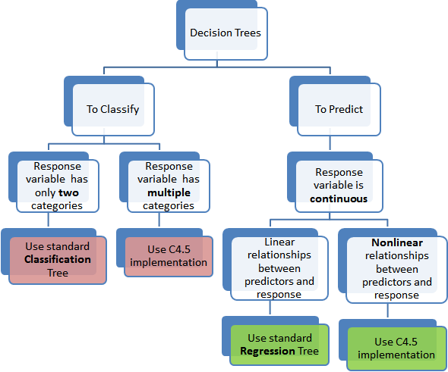

Slide 20
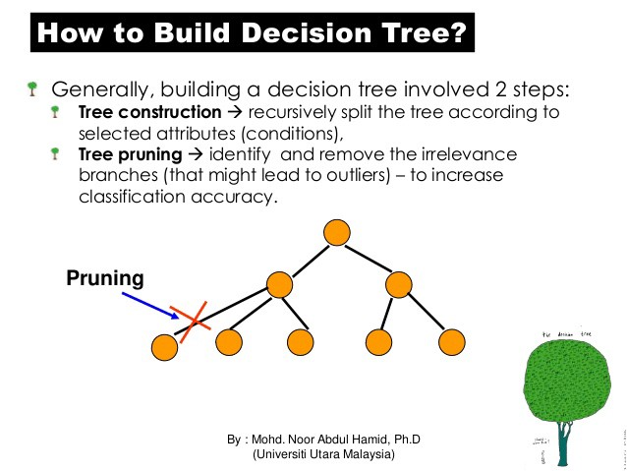

Slide 21
Methods for Expressing Test Conditions
Depends on attribute types
Binary
Nominal
Ordinal
Continuous
Depends on number of ways to split
2-way split
Multi-way split

Slide 22
Test Condition for Nominal Attributes
Multi-way split:
Use as many partitions as distinct values.
Binary split:
Divides values into two subsets

Slide 23
Test Condition for Ordinal Attributes
Multi-way split:
Use as many partitions as distinct values
Binary split:
Divides values into two subsets
Preserve order property among attribute values
This grouping violates order property

Slide 24
Test Condition for Continuous Attributes

Slide 25
Splitting Criteria for Decision Tree Induction
Attribute Selection Method is used to determine the splitting criterion.
Tells as to which branches to grow from node N with respect to outcomes chosen
Splitting criteria indicates : 1. Splitting Attribute
2. Split Point
3. Splitting Subset
Splitting Criteria is determined to check if each partitions at branch are as pure as possible

Slide 26
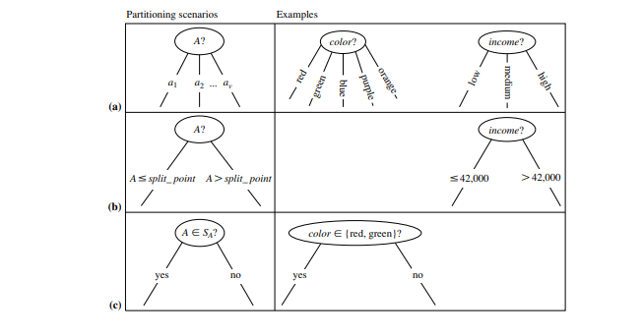
Splitting Criteria for Decision Tree Induction
Three possible scenarios: 1. Node is Discrete Valued
2. Node is Continuous Valued
3. Node is discrete valued and a Binary Tree

Slide 27
Algorithm for Decision Tree Induction
Basic algorithm (a greedy algorithm)
Tree is constructed in a top-down recursive divide-and-conquer manner
At start, all the training examples are at the root.
Attributes are categorical (if continuous-valued, they are discretized in advance)
Test attributes are selected on the basis of a heuristic or statistical measure (e.g., information gain)
Watch : https://www.youtube.com/watch?v=DCZ3tsQIoGU

Slide 28
Algorithm for Decision Tree Induction
Conditions for stopping partitioning
All samples for a given node belong to the same class
There are no remaining attributes for further partitioning – majority voting is employed for classifying the leaf
There are no samples left

Slide 29


Attribute Selection Measure
Here pi is the non zero probability that an arbitrary tuple in D belongs to class Ci.
Information is encoded in bits ,that is why log is taken
Info(D) is also known as entropy of D
More information is needed to arrive at an exact classification. Info A(D) which is the expected information required to classify a tuple.

Slide 30

Attribute Selection Measure
Information gain is defined as the difference between the Original information & Expected Information after partitioning
The attribute with highest information gain is chosen as the splitting attribute.
Info(D) should be more and Info A(D) should be less for good classification.

Slide 31
Information Gain (ID3/C4.5)
Select the attribute with the highest information gain
Assume there are two classes, P and N
Let the set of examples S contain p elements of class P and n elements of class N
The amount of information, needed to decide if an arbitrary example in S belongs to P or N is defined as

Slide 32
Information Gain in Decision Tree Induction
Assume that using attribute A a set S will be partitioned into sets {S₁, S₂ , …, S_{v}}
If S_{i} contains p_{i} examples of P and n_{i} examples of N, the entropy, or the expected information needed to classify objects in all sub trees S_{i} is
The encoding information that would be gained by branching on A

Slide 33
Attribute Selection by Information Gain Computation
Class P: buys_computer = “yes”
Class N: buys_computer = “no”
I(p, n) = I(9, 5) =0.940
Compute the entropy for age:
Hence
Similarly

Slide 34
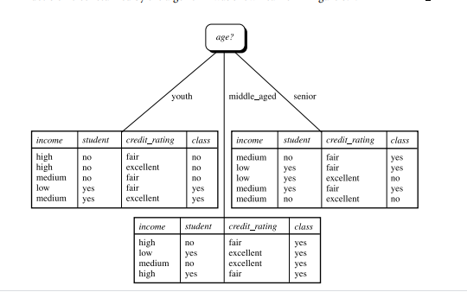
Decision Tree After Single Partition

Slide 35
Attribute Selection Measure
Information gain (ID3/C4.5)
All attributes are assumed to be categorical
The attribute with highest information gain is chosen as splitting attribute for Node N
Gini index (IBM Intelligent Miner)
All attributes are assumed continuous-valued
Assume there exist several possible split values for each attribute
May need other tools, such as clustering, to get the possible split values
Can be modified for categorical attributes

Slide 36
Extracting Classification Rules from Trees
Represent the knowledge in the form of IF-THEN rules
One rule is created for each path from the root to a leaf
Each attribute-value pair along a path forms a conjunction
The leaf node holds the class prediction
Rules are easier for humans to understand
Example
IF age = “<=30” AND student = “no” THEN buys_computer = “no”
IF age = “<=30” AND student = “yes” THEN buys_computer = “yes”
IF age = “31…40” THEN buys_computer = “yes”
IF age = “>40” AND credit_rating = “excellent” THEN buys_computer = “yes”
IF age = “>40” AND credit_rating = “fair” THEN buys_computer = “no”

Slide 37
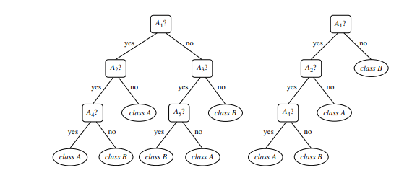
Avoid Over fitting in Classification
The generated tree may over fit the training data
Too many branches, some may reflect anomalies due to noise or outliers
Result is in poor accuracy for unseen samples
Two approaches to avoid over fitting
Pre pruning: In Pre Pruning the construction of tree is halted by deciding not to split further or partition the Training data
Post pruning:
1. In Post Pruning sub trees are removed from a fully grown tree.
2. The sub tree is pruned by removing its branches and replacing it with a leaf
3. The leaf is labeled with the most frequent class among the sub tree replaced

Slide 38
Advantages
Inexpensive to construct
Extremely fast at classifying unknown records
Easy to interpret for small-sized trees
Robust to noise (especially when methods to avoid over fitting are employed)
Can easily handle redundant or irrelevant attributes (unless the attributes are interacting)

Slide 39
Disadvantages
Space of possible decision trees is exponentially large. Greedy approaches are often unable to find the best tree.
Does not take into account interactions between attributes
Each decision boundary involves only a single attribute

Slide 40

Entropy
Entropy measures the impurity of an arbitrary collection of examples.
For a collection S, entropy is given as:
For a collection S having positive and negative examples
Entropy(S) = -p₊log₂p₊ - p₋log₂p₋
where p₊ is the proportion of positive examples
and p₋ is the proportion of negative examples
In general, Entropy(S) = 0 if all members of S belong to the same class.
Entropy(S) = 1 (maximum) when all members are split equally.

Slide 41

Information Gain
Measures the expected reduction in entropy. The higher the IG, more is the expected reduction in entropy.
where Values(A) is the set of all possible values for attribute A,
S_{v} is the subset of S for which attribute A has value v.

Slide 42
Example 1
Sample training data to determine whether an animal lays eggs.
Independent/Condition attributes |  |  |  |  | Dependent/Decision attributes
Animal | Warm-blooded | Feathers | Fur | Swims | Lays Eggs
Ostrich | Yes | Yes | No | No | Yes
Crocodile | No | No | No | Yes | Yes
Raven | Yes | Yes | No | No | Yes
Albatross | Yes | Yes | No | No | Yes
Dolphin | Yes | No | No | Yes | No
Koala | Yes | No | Yes | No | No

Slide 43

Entropy(4Y,2N): -(4/6)log₂(4/6) – (2/6)log₂(2/6)
= 0.91829
Now, we have to find the IG for all four attributes Warm-blooded, Feathers, Fur, Swims

Slide 44
For attribute ‘Warm-blooded’:
Values(Warm-blooded) : [Yes,No]
S = [4Y,2N]
S_{Yes} = [3Y,2N] E(S_{Yes}) = 0.97095
S_{No} = [1Y,0N] E(S_{No}) = 0 (all members belong to same class)
Gain(S,Warm-blooded) = 0.91829 – [(5/6)*0.97095 + (1/6)*0]
= 0.10916
For attribute ‘Feathers’:
Values(Feathers) : [Yes,No]
S = [4Y,2N]
S_{Yes} = [3Y,0N] E(S_{Yes}) = 0
S_{No} = [1Y,2N] E(S_{No}) = 0.91829
Gain(S,Feathers) = 0.91829 – [(3/6)*0 + (3/6)*0.91829]
= 0.45914

Slide 45
For attribute ‘Fur’:
Values(Fur) : [Yes,No]
S = [4Y,2N]
S_{Yes} = [0Y,1N] E(S_{Yes}) = 0
S_{No} = [4Y,1N] E(S_{No}) = 0.7219
Gain(S,Fur) = 0.91829 – [(1/6)*0 + (5/6)*0.7219]
= 0.3167
For attribute ‘Swims’:
Values(Swims) : [Yes,No]
S = [4Y,2N]
S_{Yes} = [1Y,1N] E(S_{Yes}) = 1 (equal members in both classes)
S_{No} = [3Y,1N] E(S_{No}) = 0.81127
Gain(S,Swims) = 0.91829 – [(2/6)*1 + (4/6)*0.81127]
= 0.04411

Slide 46
Gain(S,Warm-blooded) = 0.10916
Gain(S,Feathers) = 0.45914
Gain(S,Fur) = 0.31670
Gain(S,Swims) = 0.04411
Gain(S,Feathers) is maximum, so it is considered as the root node
Animal | Warm-blooded | Feathers | Fur | Swims | Lays Eggs
Ostrich | Yes | Yes | No | No | Yes
Crocodile | No | No | No | Yes | Yes
Raven | Yes | Yes | No | No | Yes
Albatross | Yes | Yes | No | No | Yes
Dolphin | Yes | No | No | Yes | No
Koala | Yes | No | Yes | No | No
The ‘Y’ descendant has only positive examples and becomes the leaf node with classification ‘Lays Eggs’
Feathers
Y
N
[Ostrich, Raven,
Albatross]
[Crocodile, Dolphin,
Koala]
Lays Eggs
?

Slide 47

Animal | Warm-blooded | Feathers | Fur | Swims | Lays Eggs
Crocodile | No | No | No | Yes | Yes
Dolphin | Yes | No | No | Yes | No
Koala | Yes | No | Yes | No | No
We now repeat the procedure,
S: [Crocodile, Dolphin, Koala]
S: [1+,2-]
Entropy(S) = -(1/3)log₂(1/3) – (2/3)log₂(2/3)
= 0.91829

Slide 48
For attribute ‘Warm-blooded’:
Values(Warm-blooded) : [Yes,No]
S = [1Y,2N]
S_{Yes} = [0Y,2N] E(S_{Yes}) = 0
S_{No} = [1Y,0N] E(S_{No}) = 0
Gain(S,Warm-blooded) = 0.91829 – [(2/3)*0 + (1/3)*0] = 0.91829
For attribute ‘Fur’:
Values(Fur) : [Yes,No]
S = [1Y,2N]
S_{Yes} = [0Y,1N] E(S_{Yes}) = 0
S_{No} = [1Y,1N] E(S_{No}) = 1
Gain(S,Fur) = 0.91829 – [(1/3)*0 + (2/3)*1] = 0.25162
For attribute ‘Swims’:
Values(Swims) : [Yes,No]
S = [1Y,2N]
S_{Yes} = [1Y,1N] E(S_{Yes}) = 1
S_{No} = [0Y,1N] E(S_{No}) = 0
Gain(S,Swims) = 0.91829 – [(2/3)*1 + (1/3)*0] = 0.25162
Gain(S,Warm-blooded) is maximum

Slide 49
The final decision tree will be:
Feathers
Y
N
Lays eggs
Warm-blooded
Y
N
Does not lay eggs
Lays Eggs

Slide 50
Example 2
Factors affecting sunburn
Name | Hair | Height | Weight | Lotion | Sunburned
Sarah | Blonde | Average | Light | No | Yes
Dana | Blonde | Tall | Average | Yes | No
Alex | Brown | Short | Average | Yes | No
Annie | Blonde | Short | Average | No | Yes
Emily | Red | Average | Heavy | No | Yes
Pete | Brown | Tall | Heavy | No | No
John | Brown | Average | Heavy | No | No
Katie | Blonde | Short | Light | Yes | No

Slide 51
S = [3+, 5-]
Entropy(S) = -(3/8)log₂(3/8) – (5/8)log₂(5/8)
= 0.95443
Find IG for all 4 attributes: Hair, Height, Weight, Lotion
For attribute ‘Hair’:
Values(Hair) : [Blonde, Brown, Red]
S = [3+,5-]
S_{Blonde} = [2+,2-] E(S_{Blonde}) = 1
S_{Brown} = [0+,3-] E(S_{Brown}) = 0
S_{Red} = [1+,0-] E(S_{Red}) = 0
Gain(S,Hair) = 0.95443 – [(4/8)*1 + (3/8)*0 + (1/8)*0]
= 0.45443

Slide 52
For attribute ‘Height’:
Values(Height) : [Average, Tall, Short]
S_{Average} = [2+,1-] E(S_{Average}) = 0.91829
S_{Tall} = [0+,2-] E(S_{Tall}) = 0
S_{Short} = [1+,2-] E(S_{Short}) = 0.91829
Gain(S,Height) = 0.95443 – [(3/8)*0.91829 + (2/8)*0 + (3/8)*0.91829]
= 0.26571
For attribute ‘Weight’:
Values(Weight) : [Light, Average, Heavy]
S_{Light} = [1+,1-] E(S_{Light}) = 1
S_{Average} = [1+,2-] E(S_{Average}) = 0.91829
S_{Heavy} = [1+,2-] E(S_{Heavy}) = 0.91829
Gain(S,Weight) = 0.95443 – [(2/8)*1 + (3/8)*0.91829 + (3/8)*0.91829]
= 0.01571
For attribute ‘Lotion’:
Values(Lotion) : [Yes, No]
SYes = [0+,3-] E(S_{Yes}) = 0
S_{No} = [3+,2-] E(S_{No}) = 0.97095
Gain(S,Lotion) = 0.95443 – [(3/8)*0 + (5/8)*0.97095]
= 0.01571

Slide 53
Gain(S,Hair) = 0.45443 Gain(S,Height) = 0.26571
Gain(S,Weight) = 0.01571 Gain(S,Lotion) = 0.3475
Gain(S,Hair) is maximum, so it is considered as the root node
Name | Hair | Height | Weight | Lotion | Sunburned
Sarah | Blonde | Average | Light | No | Yes
Dana | Blonde | Tall | Average | Yes | No
Alex | Brown | Short | Average | Yes | No
Annie | Blonde | Short | Average | No | Yes
Emily | Red | Average | Heavy | No | Yes
Pete | Brown | Tall | Heavy | No | No
John | Brown | Average | Heavy | No | No
Katie | Blonde | Short | Light | Yes | No
Hair
Blonde
Brown
Red
[Sarah, Dana,
Annie, Katie]
[Alex, Pete, John]
Not
Sunburned
?
[Emily]
Sunburned

Slide 54
Name | Hair | Height | Weight | Lotion | Sunburned
Sarah | Blonde | Average | Light | No | Yes
Dana | Blonde | Tall | Average | Yes | No
Annie | Blonde | Short | Average | No | Yes
Katie | Blonde | Short | Light | Yes | No
Repeating again:
S = [Sarah, Dana, Annie, Katie]
S: [2+,2-]
Entropy(S) = 1
Find IG for remaining 3 attributes Height, Weight, Lotion
For attribute ‘Height’:
Values(Height) : [Average, Tall, Short]
S = [2+,2-]
S_{Average} = [1+,0-] E(S_{Average}) = 0
S_{Tall} = [0+,1-] E(S_{Tall}) = 0
S_{Short} = [1+,1-] E(S_{Short}) = 1
Gain(S,Height) = 1 – [(1/4)*0 + (1/4)*0 + (2/4)*1]
= 0.5

Slide 55
For attribute ‘Weight’:
Values(Weight) : [Average, Light]
S = [2+,2-]
S_{Average} = [1+,1-] E(S_{Average}) = 1
S_{Light} = [1+,1-] E(S_{Light}) = 1
Gain(S,Weight) = 1 – [(2/4)*1 + (2/4)*1]
= 0
For attribute ‘Lotion’:
Values(Lotion) : [Yes, No]
S = [2+,2-]
S_{Yes} = [0+,2-] E(S_{Yes}) = 0
S_{No} = [2+,0-] E(S_{No}) = 0
Gain(S,Lotion) = 1 – [(2/4)*0 + (2/4)*0]
= 1
Therefore, Gain(S,Lotion) is maximum

Slide 56
In this case, the final decision tree will be
Hair
Blonde
Brown
Red
Sunburned
Not
Sunburned
Lotion
Y
N
Not
Sunburned
Sunburned

Slide 57
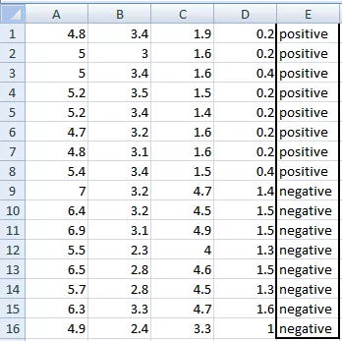
Example Data
Try creating tree using information gain splitting criteria

Slide 58
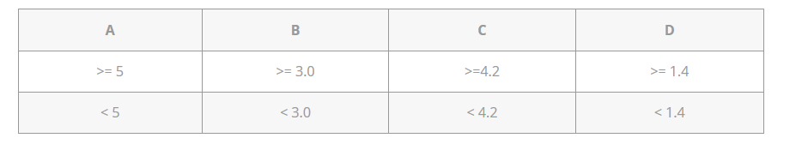
Gini Index
Gini Index is a metric to measure how often a randomly chosen element would be incorrectly identified. It means an attribute with lower gini index should be preferred.
A, B, C, D attributes can be considered as predictors and E column class labels can be considered as a target variable. For constructing a decision tree from this data, we have to convert continuous data into categorical data.
We have chosen some random values to categorize each attribute:

Slide 59

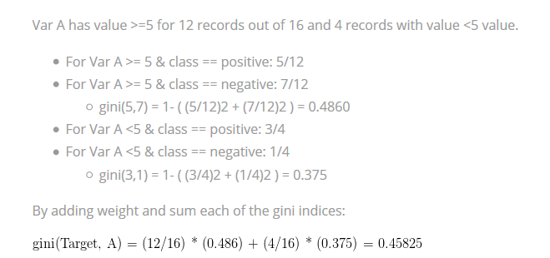
Gini Index is defined as:
Gini Index for variable A:

Slide 60
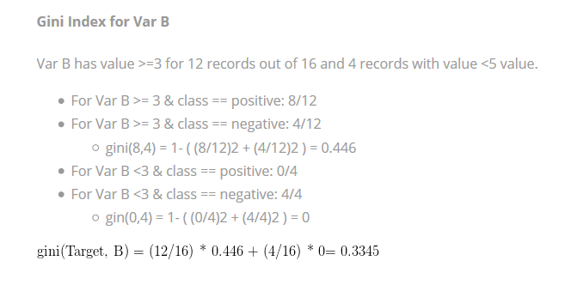
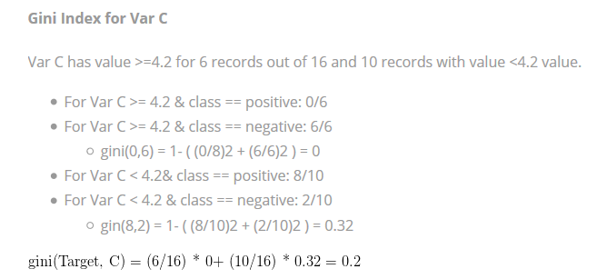

Slide 61
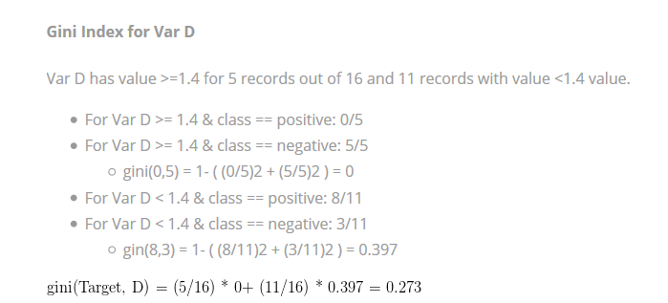

Slide 62
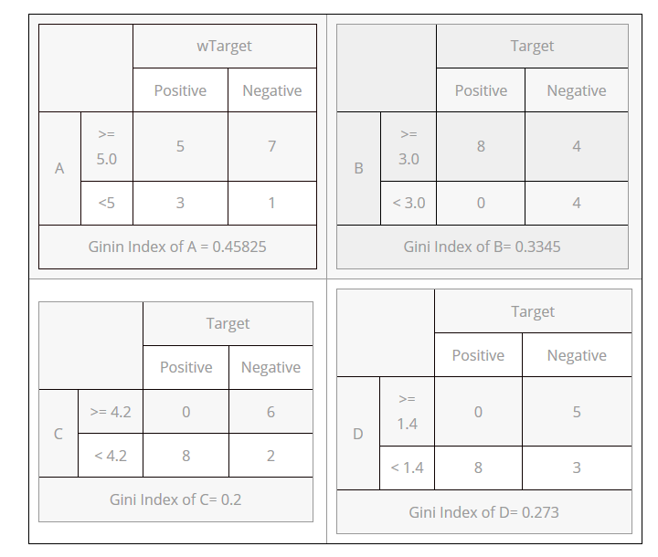

Slide 63
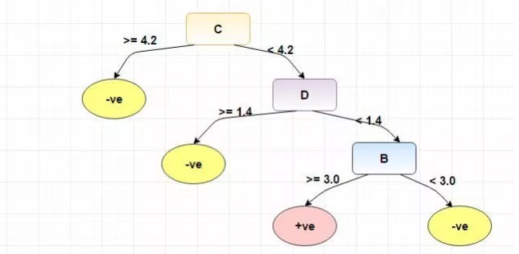

Slide 64
The Gini Index is calculated by subtracting the sum of the squared probabilities of each class from one. It favors larger partitions.
Information Gain multiplies the probability of the class times the log (base=2) of that class probability. Information Gain favors smaller partitions with many distinct values

Slide 65
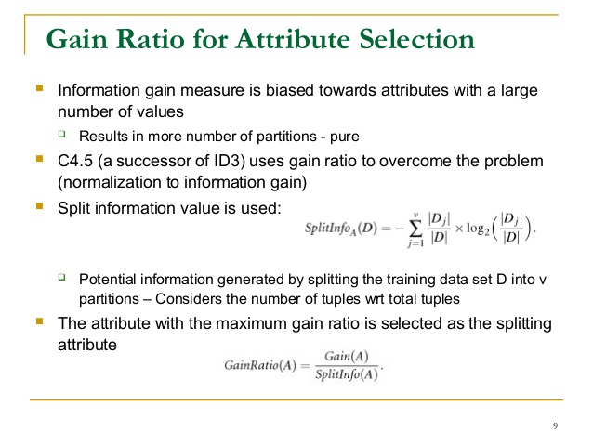
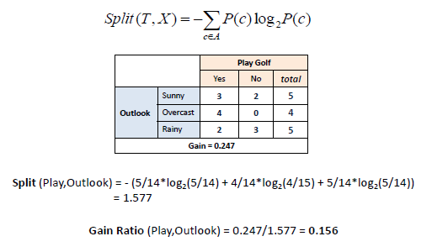
Gain Ratio

Slide 66
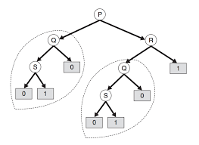
Tree Replication Problem

Slide 67
Overfitting
Overfitting is a practical problem while building a decision tree model.
The model is having an issue of overfitting is considered when the algorithm continues to go deeper and deeper in the to reduce the training set error but results with an increased test set error i.e, Accuracy of prediction for our model goes down.
It generally happens when it builds many branches due to outliers and irregularities in data.
Two approaches which we can use to avoid overfitting are:
Pre-Pruning
Post-Pruning

Slide 68
Different Types of Pruning
1) Prepruning:
In this approach, the construction of the decision tree is stopped early. It means it is decided not to further partition the branches. The last node constructed becomes the leaf node and this leaf node may hold the most frequent class among the tuples.
The attribute selection measures are used to find out the weightage of the split. Threshold values are prescribed to decide which splits are regarded as useful. If the portioning of the node results in splitting by falling below threshold then the process is halted.
2) Postpruning:
This method removes the outlier branches from a fully grown tree. The unwanted branches are removed and replaced by a leaf node denoting the most frequent class label. This technique requires more computation than prepruning, however, it is more reliable.
The pruned trees are more precise and compact when compared to unpruned trees but they carry a disadvantage of replication and repetition.
Repetition occurs when the same attribute is tested again and again along a branch of a tree. Replication occurs when the duplicate subtrees are present within the tree. These issues can be solved by multivariate splits.

Slide 69
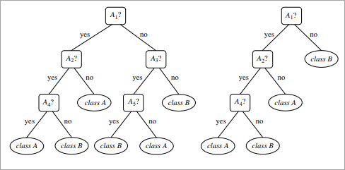
Unpruned Vs Pruned Tree

Slide 70
Decision Tree Algorithm Advantages and Disadvantages
Advantages:
Decision Trees are easy to explain. It results in a set of rules.
It follows the same approach as humans generally follow while making decisions.
Interpretation of a complex Decision Tree model can be simplified by its visualizations. Even a naive person can understand logic.
The Number of hyper-parameters to be tuned is almost null.
Disadvantages:
There is a high probability of overfitting in Decision Tree.
Generally, it gives low prediction accuracy for a dataset as compared to other machine learning algorithms.
Information gain in a decision tree with categorical variables gives a biased response for attributes with greater no. of categories.
Calculations can become complex when there are many class labels.

Slide 71
DecisionTreeClassifier() : Python Class
This is the classifier function for DecisionTree.
It is the main function for implementing the algorithms. Some important parameters are:
criterion: It defines the function to measure the quality of a split. Sklearn supports “gini” criteria for Gini Index & “entropy” for Information Gain. By default, it takes “gini” value.
splitter: It defines the strategy to choose the split at each node. Supports “best” value to choose the best split & “random” to choose the best random split. By default, it takes “best” value.
max_features: It defines the no. of features to consider when looking for the best split. We can input integer, float, string & None value.
If an integer is inputted then it considers that value as max features at each split.
If float value is taken then it shows the percentage of features at each split.
If “auto” or “sqrt” is taken then max_features=sqrt(n_features).
If “log2” is taken then max_features= log2(n_features).
If None, then max_features=n_features. By default, it takes “None” value.

Slide 72
max_depth: The max_depth parameter denotes maximum depth of the tree. It can take any integer value or None. If None, then nodes are expanded until all leaves are pure or until all leaves contain less than min_samples_split samples. By default, it takes “None” value.
min_samples_split: This tells above the minimum no. of samples reqd. to split an internal node. If an integer value is taken then consider min_samples_split as the minimum no. If float, then it shows percentage. By default, it takes “2” value.
min_samples_leaf: The minimum number of samples required to be at a leaf node. If an integer value is taken then consider min_samples_leaf as the minimum no. If float, then it shows percentage. By default, it takes “1” value.
max_leaf_nodes: It defines the maximum number of possible leaf nodes. If None then it takes an unlimited number of leaf nodes. By default, it takes “None” value.
min_impurity_split: It defines the threshold for early stopping tree growth. A node will split if its impurity is above the threshold otherwise it is a leaf.

Slide 73
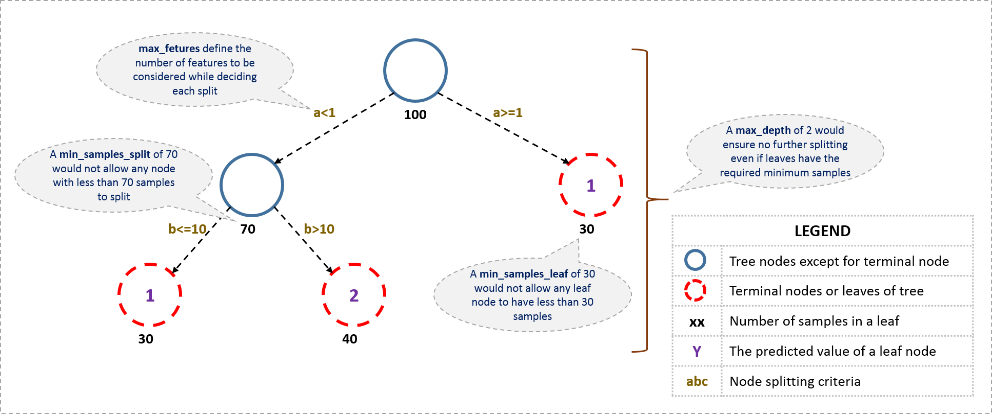

Slide 74
Are tree based algorithms better than linear models?
If the relationship between dependent & independent variable is well approximated by a linear model, linear regression will outperform tree based model.
If there is a high non-linearity & complex relationship between dependent & independent variables, a tree model will outperform a classical regression method.
If you need to build a model which is easy to explain to people, a decision tree model will always do better than a linear model. Decision tree models are even simpler to interpret than linear regression!

Slide 75
Thank You

